Slide 1
Worldview Conservation, Alteration, and Transformation
Sessions 6 and 7
Dr. Lewis Winkler • East Asia School of Theology (Singapore) Uploaded by Dr. Rick Griffith • Jordan Evangelical Theological Seminary Files in many languages for free download at BibleStudyDownloads.org

Slide 2
Introduction:

Slide 3
Why and how do worldviews change? Some General Perspectives:
Internal Dynamics:

Slide 4
Why and how do worldviews change? Some General Perspectives:
Internal Dynamics:
No worldview, no matter how conservative is completely static.

Slide 5
Why and how do worldviews change? Some General Perspectives:
Internal Dynamics:
No worldview, no matter how conservative is completely static.
The Dynamic Nature of Historically Situated Existence:

Slide 6
Why and how do worldviews change? Some General Perspectives:
Internal Dynamics:
No worldview, no matter how conservative is completely static.
The Dynamic Nature of Historically Situated Existence:
Conservative versus Liberal Worldview Systems:

Slide 7
Why and how do worldviews change? Some General Perspectives:
Internal Dynamics:
No worldview, no matter how conservative is completely static.
The Dynamic Nature of Historically Situated Existence:
Conservative versus Liberal Worldview Systems:
Isolated versus Impacted Worldview Systems:

Slide 8
Why and how do worldviews change? Some General Perspectives:
Internal Dynamics:
No worldview is completely monolithic.

Slide 9
Why and how do worldviews change? Some General Perspectives:
Internal Dynamics:
No worldview is completely monolithic.
Continuums of Adherence:

Slide 10
Why and how do worldviews change? Some General Perspectives:
Internal Dynamics:
No worldview is completely monolithic.
Continuums of Adherence:
Countercultural Dynamics:

Slide 11
Why and how do worldviews change? Some General Perspectives:
Internal Dynamics:
No worldview is completely monolithic.
Continuums of Adherence:
Countercultural Dynamics:
Societies and Minorities:

Slide 12
Why and how do worldviews change? Some General Perspectives:
Internal Dynamics:
No worldview is completely monolithic.
Continuums of Adherence:
Countercultural Dynamics:
Societies and Minorities:
Innovators and Change Agents:

Slide 13
Why and how do worldviews change? Some General Perspectives:
Internal Dynamics:
No worldview is completely monolithic.
Continuums of Adherence:
Countercultural Dynamics:
Societies and Minorities:
Innovators and Change Agents:
Rebels and Outcasts:

Slide 14
Why and how do worldviews change? Some General Perspectives:
Internal Dynamics:
No worldview is completely monolithic.
Continuums of Adherence:
Countercultural Dynamics:
Societies and Minorities:
Innovators and Change Agents:
Rebels and Outcasts:
In Extreme Cases, Civil Wars and Conflicts:

Slide 15
Why and how do worldviews change? Some General Perspectives:
External Pressures and Realities:

Slide 16
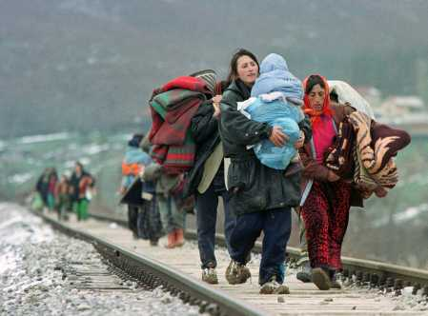
Why and how do worldviews change? Some General Perspectives:
External Pressures and Realities:
Immigration and Emigration:

Slide 17
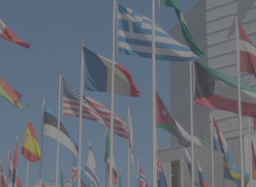
Why and how do worldviews change? Some General Perspectives:
External Pressures and Realities:
Immigration and Emigration:
International Commerce and Trade:

Slide 18
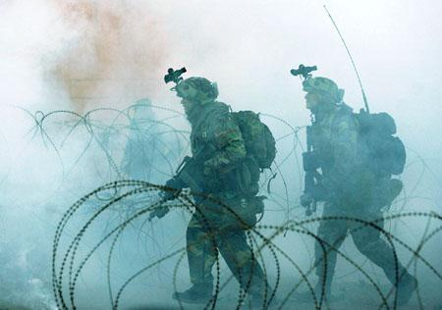
Why and how do worldviews change? Some General Perspectives:
External Pressures and Realities:
Immigration and Emigration:
International Commerce and Trade:
International Wars and Conflicts:

Slide 19
Why and how do worldviews change? Some General Perspectives:
External Pressures and Realities:
Immigration and Emigration:
International Commerce and Trade:
International Wars and Conflicts:
Widespread Rapid Travel and Worldwide Communications:

Slide 20
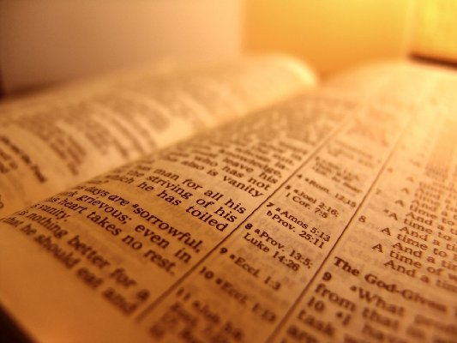
Christian Perspectives on Worldview Change:
Change comes about first and foremost through the ministry of God and His word through the power of the Holy Spirit.

Slide 21
Christian Perspectives on Worldview Change:
Change comes about first and foremost through the ministry of God and His word through the power of the Holy Spirit.
Real change involves a comprehensive restructuring and reorientation of every aspect of life.

Slide 22
Christian Perspectives on Worldview Change:
Change comes about first and foremost through the ministry of God and His word through the power of the Holy Spirit.
Real change involves a comprehensive restructuring and reorientation of every aspect of life.
Cognitive:

Slide 23
Christian Perspectives on Worldview Change:
Change comes about first and foremost through the ministry of God and His word through the power of the Holy Spirit.
Real change involves a comprehensive restructuring and reorientation of every aspect of life.
Cognitive:
Affective:

Slide 24
Christian Perspectives on Worldview Change:
Change comes about first and foremost through the ministry of God and His word through the power of the Holy Spirit.
Real change involves a comprehensive restructuring and reorientation of every aspect of life.
Cognitive:
Affective:
Evaluative:

Slide 25
Christian Perspectives on Worldview Change:
Total life change can come both incrementally and radically.

Slide 26
Christian Perspectives on Worldview Change:
Total life change can come both incrementally and radically.
By its very nature, the church is simultaneously a worldview within a worldview as well as a countercultural worldview. Thus, Christians in any and every culture should be both within the culture and distinctly different from the culture in genuinely Christian ways.

Slide 27
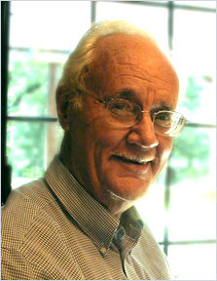
We are to be like salt and yeast, bringing about transformation in the world. One danger is to withdraw and form Christian communities that have no impact on the world. Another is to become so captive to our culture that we lose the gospel. We are to live as a countercultural community and as individuals in the world, exemplifying Christlikeness.
Paul Hiebert, Transforming Worldviews, 333

Slide 28
Christian Perspectives on Worldview Change:
From a Christian perspective, while some changes are imperative, not all change is necessarily desirable.

Slide 29
Christian Perspectives on Worldview Change:
From a Christian perspective, while some changes are imperative, not all change is necessarily desirable.
Recent changes in global migrations and information exchange have given Christians unprecedented opportunities for outreach and growth as well as unparalleled challenges, risks, and difficulties.

Slide 30
Christian Perspectives on Worldview Change:
From a Christian perspective, while some changes are imperative, not all change is necessarily desirable.
Recent changes in global migrations and information exchange have given Christians unprecedented opportunities for outreach and growth as well as unparalleled challenges, risks, and difficulties.
When Christianity appears to lack the resources to manage certain aspects of change, the problem does not lie within Christianity, but within our historically embedded interpretations and applications of Christianity.

Slide 31
Christian Strategies for Worldview Conservation, Alteration, and Transformation:
Indigenization and Pilgrimage: Incarnating God’s Cross-cultural, Trans-temporal Truth:

Slide 32
Christian Strategies for Worldview Conservation, Alteration, and Transformation:
Indigenization and Pilgrimage: Incarnating God’s Cross-cultural, Trans-temporal Truth:
First and foremost, prioritize frequent and regular time studying and being saturated with God’s word (Romans 12:1-2; Hebrews 4:12).

Slide 33
Christian Strategies for Worldview Conservation, Alteration, and Transformation:
Indigenization and Pilgrimage: Incarnating God’s Cross-cultural, Trans-temporal Truth:
First and foremost, prioritize frequent and regular time studying and being saturated with God’s word (Romans 12:1-2; Hebrews 4:12).
Take the time to discern the difference between the non-negotiable truths of Scripture and the various cultural expressions of Christianity that have been offered both through time as well as are in the contemporary context.

Slide 34
Christian Strategies for Worldview Conservation, Alteration, and Transformation:
Indigenization and Pilgrimage: Incarnating God’s Cross-cultural, Trans-temporal Truth:
Critically listen to and learn from other cultural expressions of the Christian faith.

Slide 35
Christian Strategies for Worldview Conservation, Alteration, and Transformation:
Indigenization and Pilgrimage: Incarnating God’s Cross-cultural, Trans-temporal Truth:
Critically listen to and learn from other cultural expressions of the Christian faith.
Use Spirit-filled imagination and creativity to incarnate God’s truth in every time and place.

Slide 36
Christian Strategies for Worldview Conservation, Alteration, and Transformation:
Christian Strategies for Worldview Alteration and Transformation: Evangelism:

Slide 37
Christian Strategies for Worldview Conservation, Alteration, and Transformation:
Christian Strategies for Worldview Alteration and Transformation: Evangelism:
Remember that it is God alone, through the power of the Spirit and His word, who brings about genuine life change (John 16:8; Hebrews 4:12).

Slide 38
Christian Strategies for Worldview Conservation, Alteration, and Transformation:
Christian Strategies for Worldview Alteration and Transformation: Evangelism:
Remember that it is God alone, through the power of the Spirit and His word, who brings about genuine life change (John 16:8; Hebrews 4:12).
Create scenarios and provide opportunities that make perspective change more likely.

Slide 39
Christian Strategies for Worldview Conservation, Alteration, and Transformation:
Christian Strategies for Worldview Alteration and Transformation: Evangelism:
Remember that it is God alone, through the power of the Spirit and His word, who brings about genuine life change (John 16:8; Hebrews 4:12).
Create scenarios and provide opportunities that make perspective change more likely.
Cognitive:

Slide 40
Christian Strategies for Worldview Conservation, Alteration, and Transformation:
Christian Strategies for Worldview Alteration and Transformation: Evangelism:
Remember that it is God alone, through the power of the Spirit and His word, who brings about genuine life change (John 16:8; Hebrews 4:12).
Create scenarios and provide opportunities that make perspective change more likely.
Cognitive:
Affective:

Slide 41
Christian Strategies for Worldview Conservation, Alteration, and Transformation:
Christian Strategies for Worldview Alteration and Transformation: Evangelism:
Remember that it is God alone, through the power of the Spirit and His word, who brings about genuine life change (John 16:8; Hebrews 4:12).
Create scenarios and provide opportunities that make perspective change more likely.
Cognitive:
Affective:
Evaluative:

Slide 42
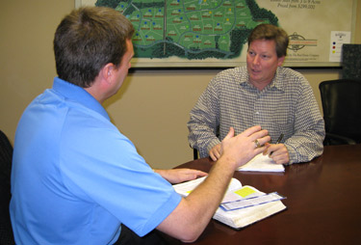
Christian Strategies for Worldview Conservation, Alteration, and Transformation:
Christian Strategies for Worldview Alteration and Transformation: Discipleship:

Slide 43
Christian Strategies for Worldview Conservation, Alteration, and Transformation:
Christian Strategies for Worldview Alteration and Transformation: Discipleship:
Remember that it is God alone, through the power of the Spirit and His word, who brings about genuine life change (Jeremiah 23:29; Romans 12:1-2; Hebrews 4:12;).

Slide 44
Christian Strategies for Worldview Conservation, Alteration, and Transformation:
Christian Strategies for Worldview Alteration and Transformation: Discipleship:
Create scenarios and provide opportunities that make perspective change more likely.

Slide 45
Christian Strategies for Worldview Conservation, Alteration, and Transformation:
Christian Strategies for Worldview Alteration and Transformation: Discipleship:
Create scenarios and provide opportunities that make perspective change more likely.
Cognitive:

Slide 46
Christian Strategies for Worldview Conservation, Alteration, and Transformation:
Christian Strategies for Worldview Alteration and Transformation: Discipleship:
Create scenarios and provide opportunities that make perspective change more likely.
Cognitive:
Affective:

Slide 47
Christian Strategies for Worldview Conservation, Alteration, and Transformation:
Christian Strategies for Worldview Alteration and Transformation: Discipleship:
Create scenarios and provide opportunities that make perspective change more likely.
Cognitive:
Affective:
Evaluative:

Slide 48
Christian Strategies for Worldview Conservation, Alteration, and Transformation:
Christians Strategies for Worldview Alteration and Transformation: Broader Cultural Engagement:

Slide 49
Conclusion:

Slide 50
Black

Slide 51
Worldview link at BibleStudyDownloads.org
Get this presentation for free!
Notes:
WV (Worldviews)

